Slide 1
Data Analysts and Data Scientists comparison
Made by:
Bashayer Al-Ahmari
Raheed Al-Baloud
Razan Al-Bishri
Suha Shafi

Slide 2
Table of contents
01
04
02
05
03
06
Difference and Similarities Between Data Analysts and Data Scientists
Introduction
Data Analysts
Case Study
Data Scientists
Conclusion

Slide 3
01
Introduction
Data Analysts? Data Scientists? Aren’t they the same?

Slide 4
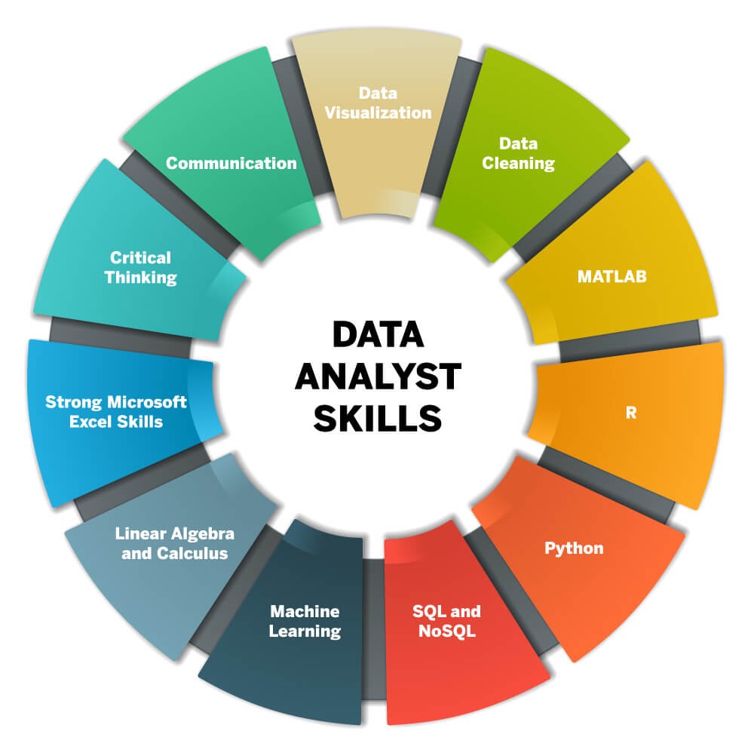
Data Analysts
Definition: “A data analyst collects, cleans, and interprets data sets in order to answer a question or solve a problem.”
Skills
Gathering Data

Slide 5
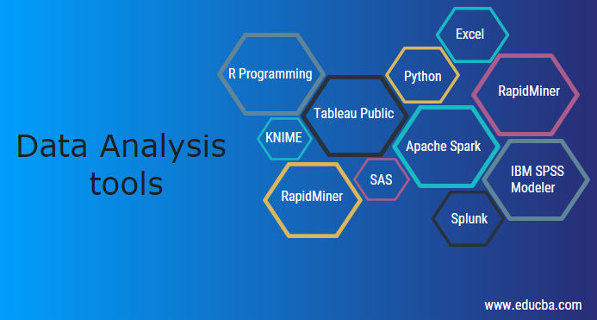
Cont'd Data Analysts
Data Analysts tools
Data Analysts model
Regression

Slide 6
Data Scientists
Data scientists are analytical experts who deal with big data, collecting and analyzing large sets of structured and unstructured data.

Slide 7
Cont'd Data Scientists
The roles and responsibilities of a data scientist include:
Gathering raw data
Designing predictive models
Developing tools
Building data visualization tools
simplify data problems

Slide 8
Difference and Similarities
Discover opportunities with current data
Machine learnings skills
Clean data
Math & statistics
Python, R, SQL
Data visualization
Business insights
Solve a problem with pre-existing data
Excel skills
Produce reports
Data Scientist
Data Analysts

Slide 9
Case Study
"Daily mixes" are those playlists that Spotify generates by itself. These playlists include the songs that are either saved by the users or are of the artists followed by them or maybe something new that they may like.

Slide 10
Conclusion
Data analyst and data scientist skills do overlap but there is a significant difference between the two. Both the job roles require some basic math, understanding of algorithms, good communication skills and knowledge of software engineering.

Slide 11
Thanks For Listening

Slide 12
Resources
Johnson, D. (2022, May 14). What is data analysis? research: Types: Methods: Techniques. Guru99. Retrieved May 22, 2022, from https://www.guru99.com/what-is-data-analysis.html#4
What's the difference between data analysts and data scientists? KDnuggets. (n.d.). Retrieved May 22, 2022, from https://www.kdnuggets.com/2022/03/difference-data-analysts-data-scientists.html
Smith, A. Q., Jeevan, A. M., Doyle, A. M. P., Lakshminarayanan, A. A., McClure, A. S., Feng, A. L. L., &amp; Piletic, A. P. (2018, December 26). 6 of my favorite case studies in Data Science. Big Data Made Simple. Retrieved May 22, 2022, from https://bigdata-madesimple.com/6-of-my-favorite-case-studies-in-data-science/
Data science case studies - why is Data Science regarded as a revolution? TechVidvan. (2021, June 27). Retrieved May 22, 2022, from https://techvidvan.com/tutorials/data-science-case-studies/
11 data analyst skills you need to get hired in 2022. Columbia Engineering Boot Camps. (2021, December 22). Retrieved May 22, 2022, from https://bootcamp.cvn.columbia.edu/blog/data-analyst-skills/
Danielle Gagnon,. Mar 15, 2022. (n.d.). What does a data analyst do? Southern New Hampshire University. Retrieved May 23, 2022, from https://www.snhu.edu/about-us/newsroom/stem/what-does-a-data-analyst-do
Coursera. (2022, May 2). What does a data analyst do? 2022 career guide. Coursera. Retrieved May 23, 2022, from https://www.coursera.org/articles/what-does-a-data-analyst-do-a-career-guide
What is a Data Scientist? Master's in Data Science. (n.d.). Retrieved March 23, 2021, from https://www.mastersindatascience.org/careers/data-scientist/
Data Analyst vs. data scientist: What's the difference? Coursera. (n.d.). Retrieved May 23, 2022, from https://www.coursera.org/articles/data-analyst-vs-data-scientist-whats-the-difference
Difference between Data Analyst and Data Scientist. (2022). Retrieved 22 May 2022, from https://www.projectpro.io/article/difference-between-data-analyst-and-data-scientist/332

